Slide 1
ES 22 Lecture slides
Human Population Dynamics

Slide 2
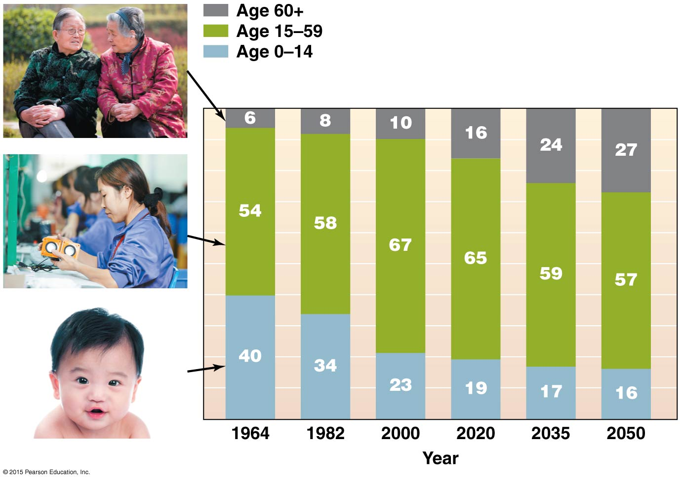
The challenge of population growth control in China has been to avoid the ”Japan” scenario of an ageing population with few young people to take care of the old.
China is now relaxing the one and two child policy to avoid the problem of a geriatric society.

Slide 3
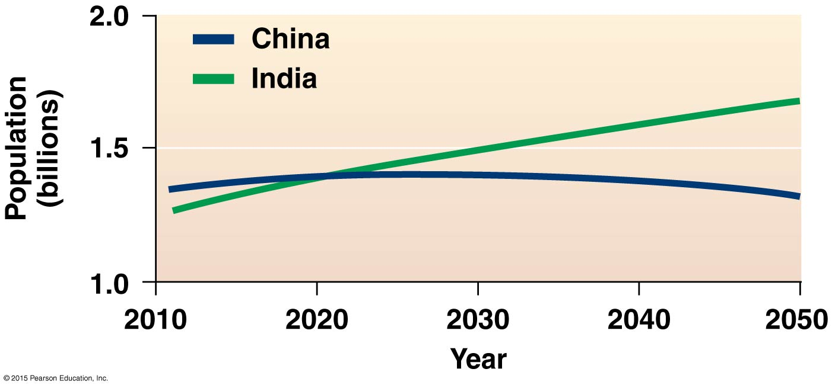
China’s relatively coercive family planning has resulted in a stabilization of their population at less than 1.5 billion people where it is today. India’s will be twice that of China by midcentury.

Slide 4
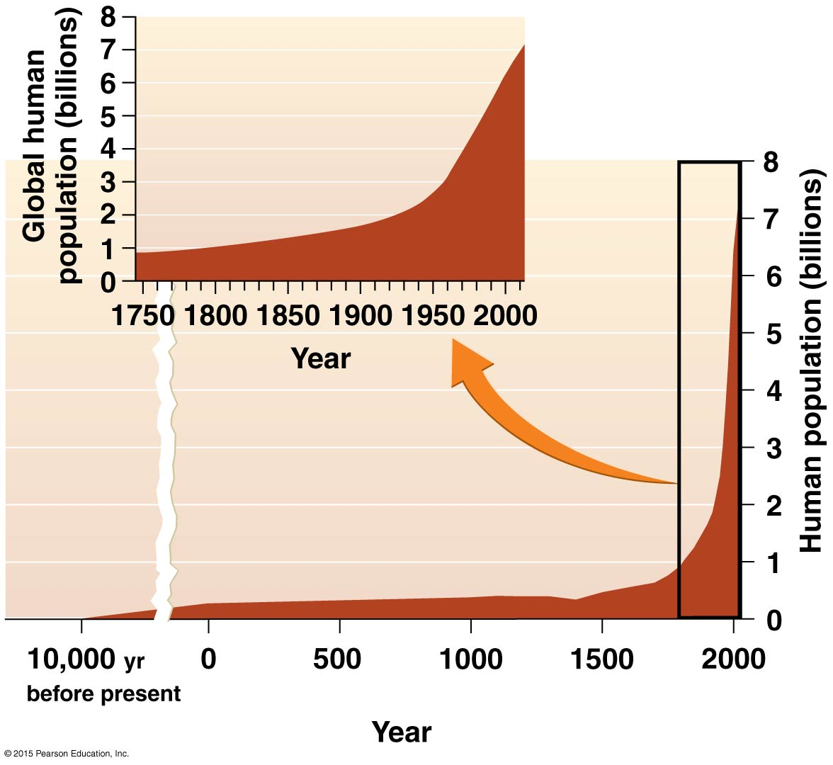
The “J” curve points to the sudden explosion of human numbers after the beginning of the industrial revolution in 1750 after thousands of years at under half a billion. Today we are at 7.6 billion. The population has more than doubled in my lifetime. The image is used by neo-Malthusians to convey a sense of alarm.

Slide 5
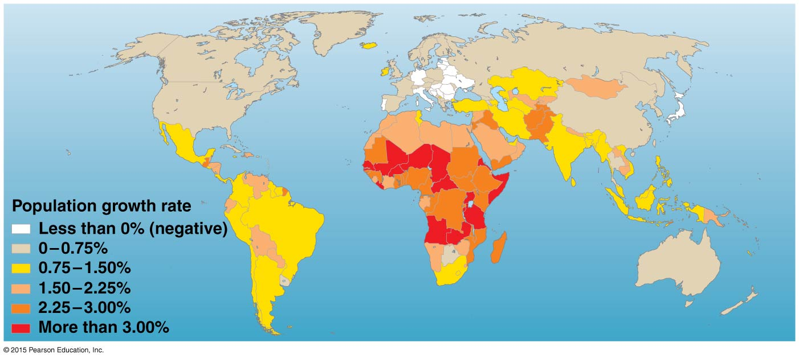

Slide 6
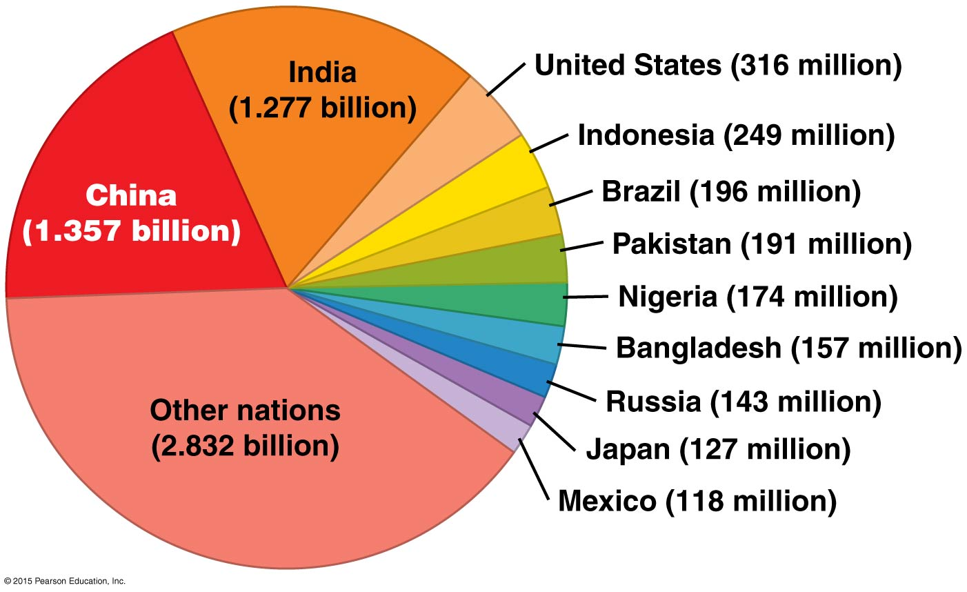

Slide 7
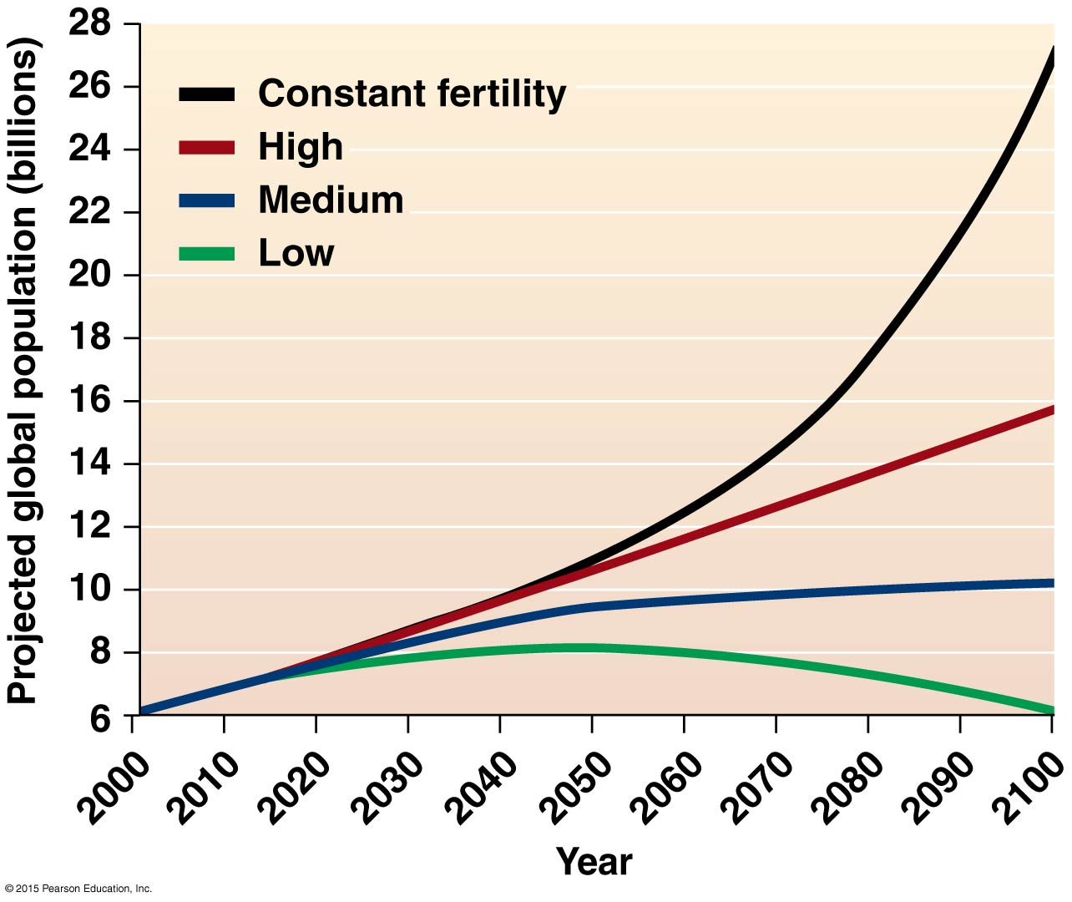
Projections depend on many variables. The constant fertility scenario is already not happening as fertility rates fall the world over. The high scenario is not likely since it represents a linear progress with no checks. The Medium scenario is the most likely. The low scenario is also not likely.

Slide 8
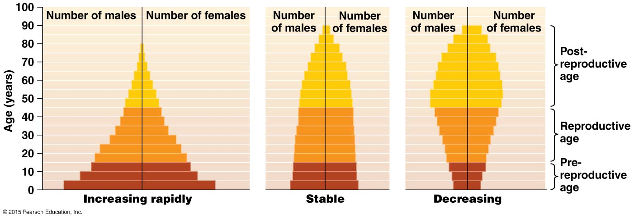
Population “pyramids” say a lot about the structure of a population and the trend for growth. They divide the whole population by (binary) gender and age. Many sub-Sharan countries in Africa look like the pyramid on the left. Japan looks like the one on the right. The US and China look like the middle one.

Slide 9
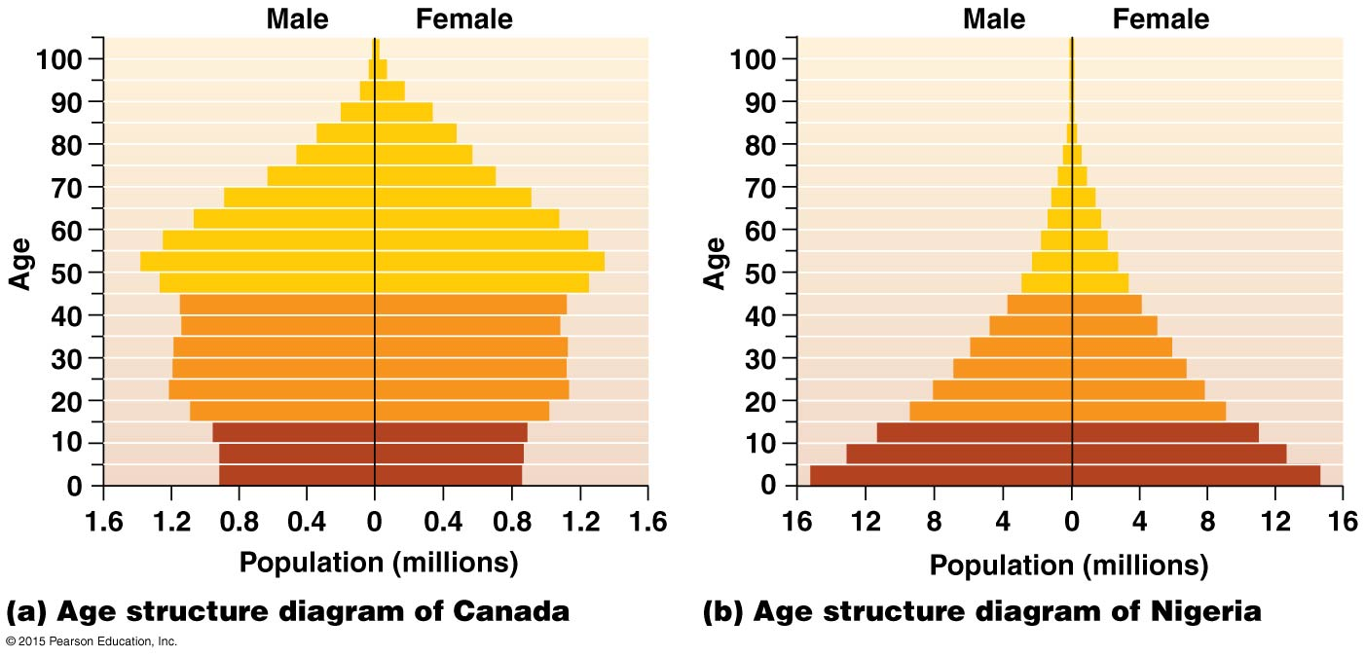

Slide 10
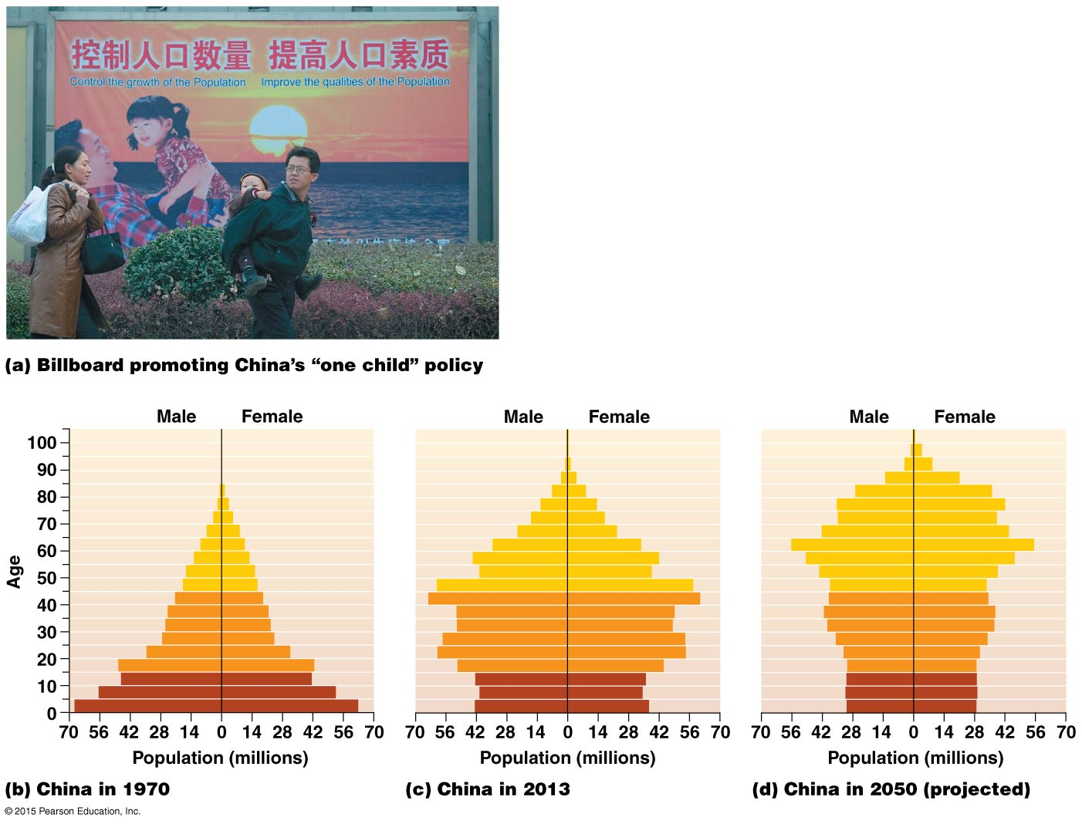
As the Chinese government projects its population growth it also tried to make having a girl as attractive as having a boy. Today gender-selective abortion is common in China for couples wanting to comply with the one child policy but preferring a son. The population in China today is skewed toward more males as a result. A natural structure is usually 51% female.

Slide 11
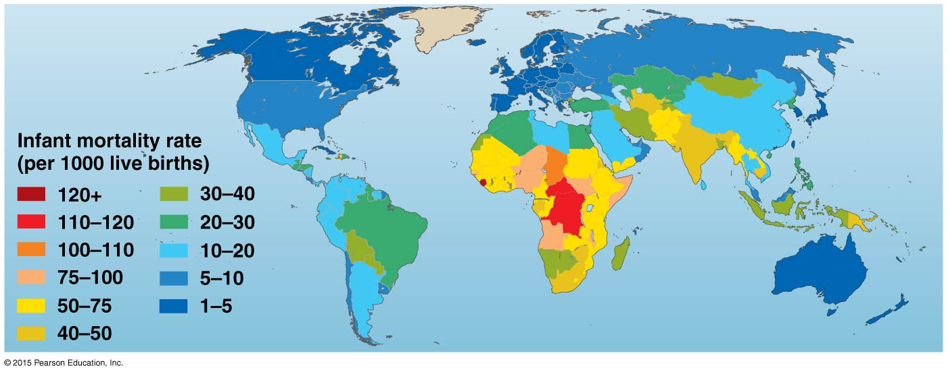
Infant mortality (death before 5years of age) is increased by malnutrition, displacement, lack of medical assistance and poverty. But not all poor countries have a high level of infant mortality Cuba has a level lower than that of the US because of extensive pre-natal and infant care support.

Slide 12
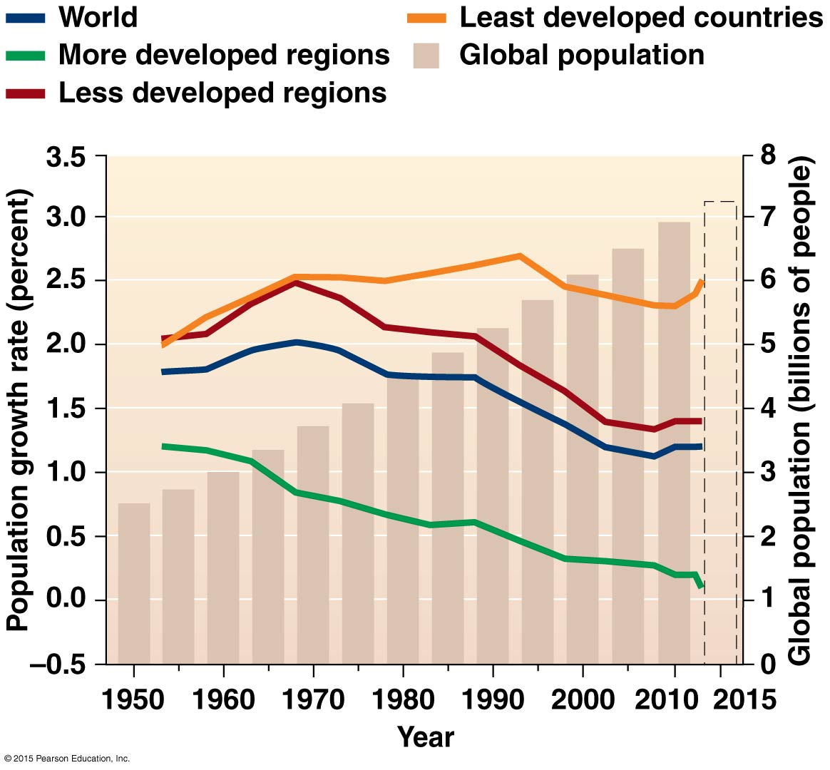
Despite overall increase in global population, the rate of growth is declining in most of the world. This is not well understood since the assumption has always been that only increased affluence reduces fertility rates.

Slide 13
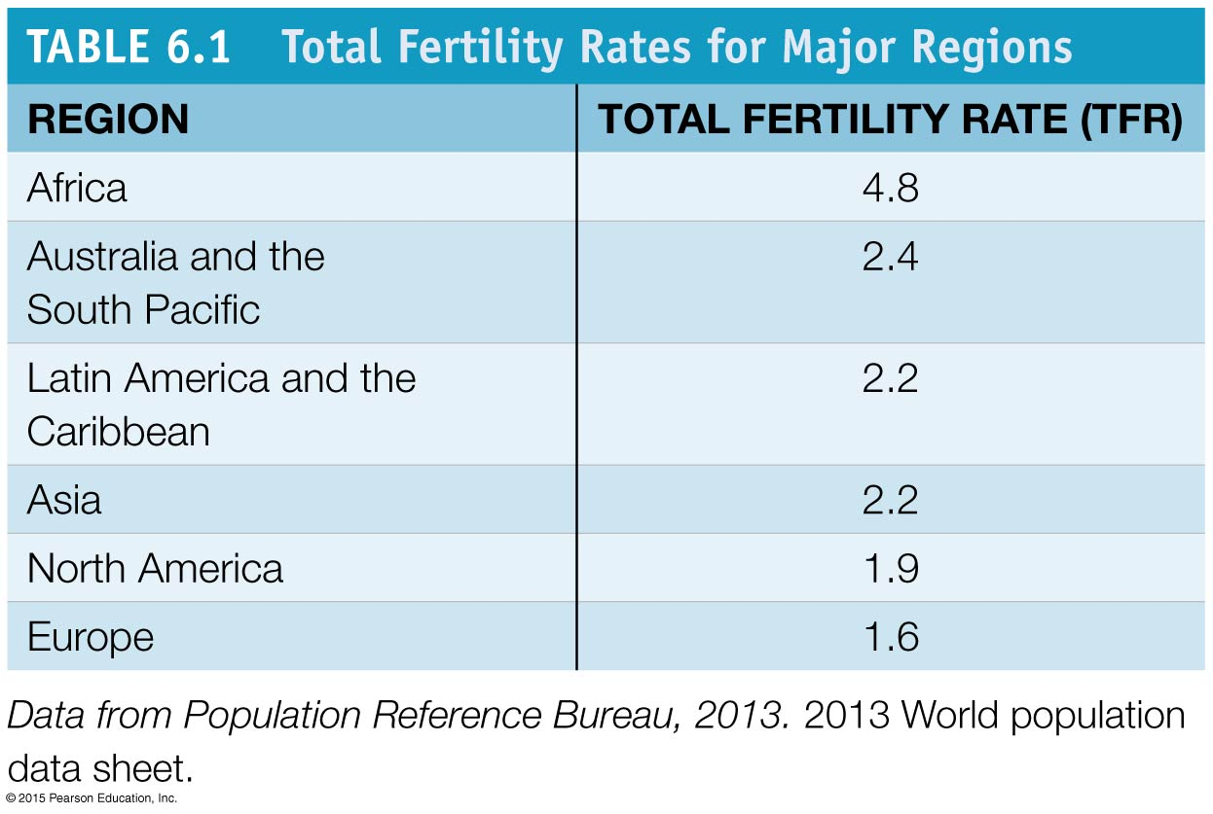
TFR remains highest in Africa. North America and Europe are “below replacement”. The US “solves” that problem with a relatively liberal policy toward immigration.

Slide 14
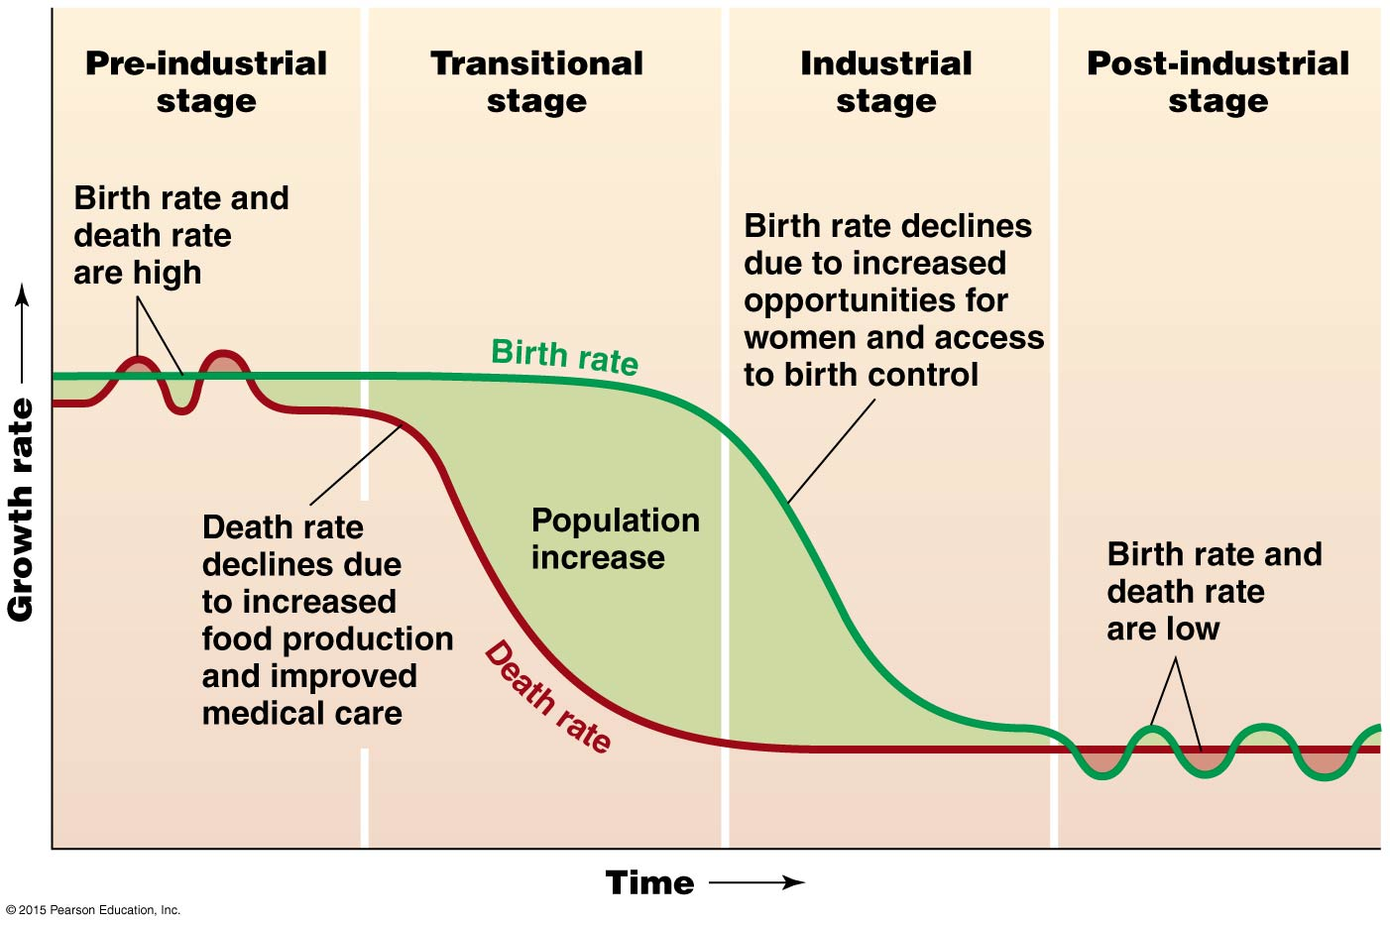
The “demographic transition, first seen in Western countries as these experienced industrialization, is now a global trend, even in non-industrial countries. Most countries today are in stage 3, the industrial stage.

Slide 15
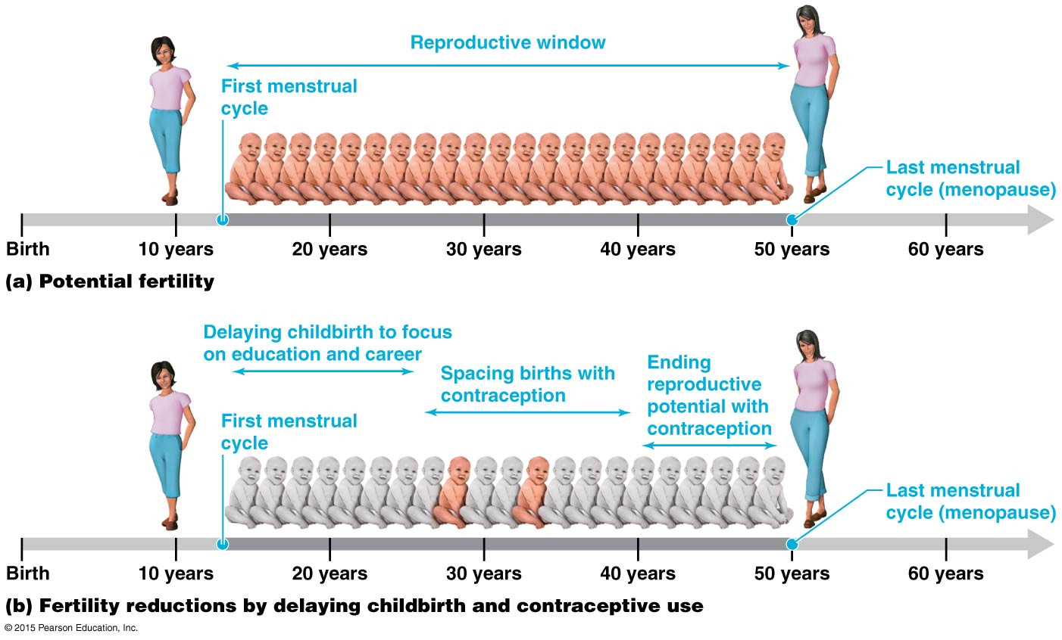
Women in many urbanized countries delay their first-born child until they have secured for themselves an education and career. This reduces fertility overall.

Slide 16
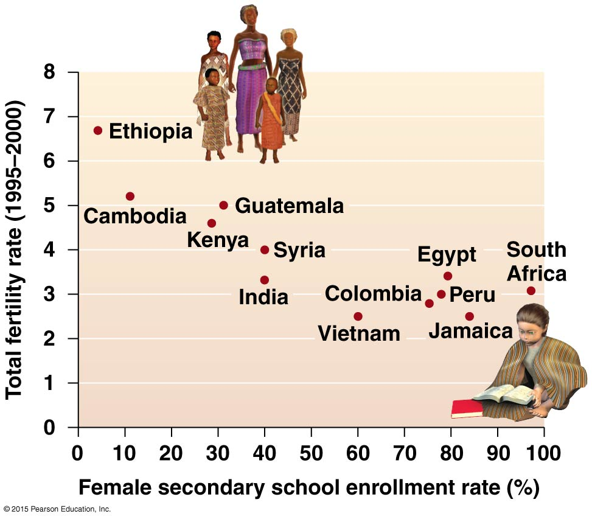
Education remains the single most determining social variable in the ability of young women to take control over their own bodies, their own fertility. This variable might determine the success of family planning clinics and the availability of birth control.

Slide 17
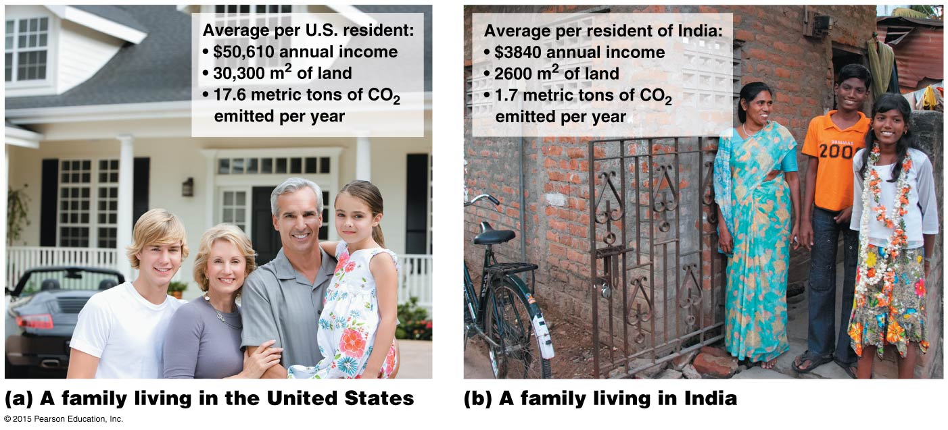
Comparing the consumption impacts of two families, one in suburban US, the other in India, shows why associating environmental decline with the fertility rates of the poor in poor countries is wrong. At less than 4% of the world’s population, Americans consume the lion’s share of natural resources.

